Slide 1
Node.js: Communication and Round Robin way
View Mastering Node.js course details at www.edureka.co/mastering-node-js
For Queries:
Post on Twitter @edurekaIN: #askEdureka
Post on Facebook /edurekaIN
For more details please contact us:
US : 1800 275 9730 (toll free)
INDIA : +91 88808 62004
Email Us : sales@edureka.co

Slide 2
Objectives
At the end of the session you will be able to learn:
Introduction of Node.js & NPM
Use Cases of Node.js
Network Communication in Node.js
Two Way Communication in Node.js
Cluster Round Robin Load Balancing

Slide 3
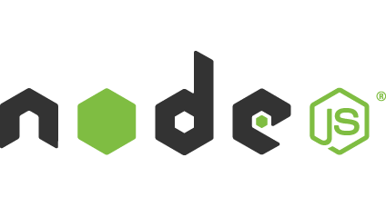
What is Node.js ?
Node.js is an open source, cross-platform runtime environment for server-side and networking applications
Node.js applications are written in JavaScript, and can be run within the Node.js runtime on OS X, Microsoft Windows, Linux, FreeBSD, NonStop and IBM. -- Wikipedia
This is based on Google’s V8 JavaScript Engine

Slide 4
What is Node.js ? (Contd.)
Guess What ?
IT’s SINGLE THREADED !!
No worries about : race conditions, deadlocks and other problems that go with multi-threading.
“Almost no function in Node directly performs I/O, so the process never blocks. Because nothing blocks, less-than-expert programmers are able to develop scalable systems.” - (courtesy : nodejs.org)
Event Queue
Thread Pool
file system
Event
Loop
network
process
other

Slide 5
Basics of Node.js : npm
npm used to stand for Node Package Manager. However it is not an acronym anymore. npm is not a Node.js specific tool
npm is a registry of reusable modules and packages written by various developers
Yes, you can publish your own npm packages
There are two ways to install npm packages :
Locally : To use and depend on the package from your own module or project
Globally: To use across the system, like a command line tool

Slide 6

Use-Cases of Node.js
Advantages
Server Side Web Applications
Server Side Web Applications
Walmart executives believe that the benefit of using Node.js was far greater than any risk in adopting a new technology
They re-engineered their mobile app to run on Node.js where all the front end code gets executed on back-end
“We rely on services all over the world,” says Almaer (V.P Mobile Architecture) “We do not control all of those services. Node allows us to front all these services… and scale up very nicely. It’s perfect for what we’re doing in mobile.”

Slide 7

Use-Cases of Node.js (Contd.)
Advantages
Highly Scalable
Server Side Web Applications
Highly Scalable
Linkedin is also leaning heavily on Node.js (Linkedin mobile and tablet app is 95% html/web based)
“We’re still full-on Node. We are excited that it can scale,” says Kiran Prasad (Head of Linkedin’s Mobile Development Team). “Over the past few months, we’ve made performance tweaks so we can scale even more. On four boxes, we can now handle 20 times the load we were handling before.”

Slide 8

Use-Cases of Node.js (Contd.)
Advantages
Low Memory Consumption
Server Side Web Applications
Highly Scalable
Low Memory Consumption
When he first built Voxer, Matt Ranney (Voxer’s CTO) ran a test to see how many connections he could open on a single server. "I just decided to open as many connections as I could, just to see where things would fall down," Ranney says
"With Node, I could open, well, all of them. I couldn't open any more connections without getting more IP addresses on my test machine. Node uses such small amounts of memory, it's astounding. I ran out of port numbers."

Slide 9


Use-Cases of Node.js (Contd.)
Advantages
Increase engineering clock speed
Improve end user experience
Server Side Web Applications
Highly Scalable
Low Memory Consumption
Increase engineering clock speed
Improve end user experience
eBay launched ql.io, a gateway for HTTP APIs, using Node.js as the runtime stack. eBay was able to tune a regular quality Ubuntu workstation to handle more than 120,000 active connections per Node.js process with each connection consuming about 2K of memory.

Slide 10
Network Communication - TCP
For Network communication on Node.js, we use the “net” module
net.createServer([options][,callback]) :
If allowHalfOpen is true then when the other side initiates Connection Termination the server WILL NOT send the FIN packet
The socket becomes non-readable but not writable. You must call the end() function explicitly
If pauseOnConnect is true then, the socket associated with each incoming connection is paused, no data transmitted from its handle until resume() is called on it
The last argument, callback, automatically works as the callback function for the “connection” event (described later)
//options object
{
allowHalfOpen : false , pauseOnConnect : false
}
//values : true or false, default : false

Slide 11
Network Communication - TCP
//Creating a TCP Server
var net = require(‘net’);
var server = net.createServer(function(socket)
{
socket.end(‘Hello World’); //Socket is a Duplex stream
});
server.listen(3000,function()
{
console.log(“Server is listening on Port 3000”);
});

Slide 12
Network Communication - TCP
//A TCP client
var net = require(‘net’);
var socket = net.createConnection({port: 3000,host: ‘192.168.0.1’);
socket.on(‘connect’,function()
{
console.log(‘connected to the server’);
})
socket.end(‘Hello Server’);
//we can now create a command line TCP chat server and client by using the //process.stdin (Readable Stream) and process.stdout(Writable)

Slide 14
Two Way Communication : Socket.io
Socket.io is a fast, real-time engine. It is an npm package.
Transmitting messages and Receiving message between client and server is simple: Events.
On server/client when sending a message use socket.emit(‘eventname’,data). “eventname” can be any string
And data can be any data: even Binary data!
On server/client when you want to listen to events-messages use socket.on(‘eventname’,callbackFunction).
Where the callbackFunction is a function that accepts a Data argument : Data sent by the other party.

Slide 15
Two Way Communication : Socket.io
A simple example:
//Server-side
var app = require('express')(); var server = require('http').Server(app); var io = require('socket.io')(server); server.listen(80); app.get('/', function (req, res) { res.sendfile(__dirname + '/index.html'); }); io.on('connection', function (socket) { socket.emit('news', { hello: 'world' }); socket.on('my other event', function (data) { console.log(data); }); });
//client-side
<script src="/socket.io/socket.io.js"></script> <script> var socket = io.connect('http://localhost'); socket.on('news', function (data) { console.log(data); socket.emit('my other event', { my: 'data' }); }); </script>

Slide 16
Two Way Communication : Socket.io
Besides ‘connect’, ‘message’ and ‘disconnect’ you can use any custom event names
You could also have a separation of concerns by namespacing. Namespacing also means, that the same websocket connection is used but is multiplexed
var io = require('socket.io').listen(80); var chat = io .of('/chat') .on('connection', function (socket) { socket.emit('a message', { that: 'only' , '/chat': 'will get' }); }); var news = io .of('/news') .on('connection', function (socket) { socket.emit('item', { news: 'item' }); });
<script> var chat = io.connect('http://localhost/chat') , news = io.connect('http://localhost/news'); chat.on('connect', function () { chat.emit('hi!'); }); news.on('news', function () { news.emit('woot'); }); </script>

Slide 18
Cluster Round Robin Load Balancing
Cluster module will set up a master and then fork your server app as many times as you want it to (also called a worker).
It communicates with workers via IPC channels and comes with an embedded load-balancer which uses Round-robin algorithm to better distribute load among the workers.
In Round Robin approach, the master process listens on a port, accepts new connections and distributes them across the workers in a round-robin fashion, with some built-in smarts to avoid overloading a worker
For Round Robin, cluster.schedulingPolicy is cluster.SCHED_RR . SCHED_RR is default on all operating systems except Windows
NODE_CLUSTER_SCHED_POLICY environment variable can also be used to set cluster.schedulingPolicy , for round robin the value will be ‘rr’

Slide 20
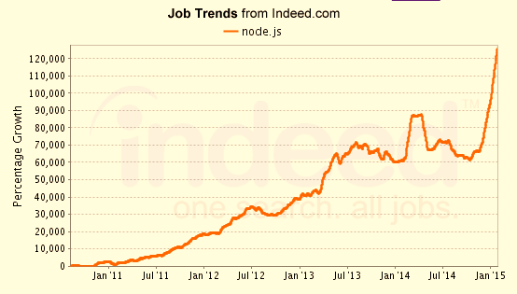
Job Trends
Salaries for Node.js Developers are already in the $60,000 range and much more.
From the graph below : The number of jobs are skyrocketing.

Slide 21
Course Topics
Module 1
Introduction to Objects in Javascript & Node.js
Module 2
Modules / Packages
Module 3
Events & Streams
Module 4
Network Communication & Web Technology in Node.js
Module 5
Building a Web Application
Module 6
Real-time Communication
Module 7
Forks, Spawns and the Process Module
Module 8
Testing in Node.js
Module 9
Node.js in the Tech World

Slide 22
Course Features

